Slide 1
ENGR 12
Dr. Mandala
Notes:
Down

Slide 2
Peer Review due leave on desk
TA will collect the documents from your desk
Score uploaded on CourseWeb

Slide 3
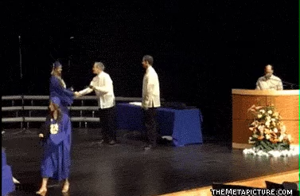
You guys made it!

Slide 4
Midterm
Computer Test (190 points)
Average: 141
Median: 145
Written Test (172 points)
Average: 167
Median: 173
Overall Midterm (100%)
Average: 85%
Median: 87%

Slide 5
C and its history
Developed by Dennis Ritchie between 1969-73 at Bell Labs
Designed to re-implement UNIX
Most widely used programming language of all time
Works on nearly all architectures (given a suitable compiler)
C has been standardized by ISO
Static type-check
Variable types are checked at compile time
*dynamic type-check, checks at run time
Low-level
Can give you low-level access to memory locations using pointers

Slide 6
C in todays world
Used for systems programming:
Operating systems
Microcontrollers (automobiles, airplanes etc.)
Embedded processors (phones, portable electronics etc.)
DSP processors (audio, tv systems etc.)
Reasons:
It has no runtime dependencies (except main())
Direct memory access
Efficient byte-level manipulation
All C code has direct 1-1 mapping to machine code
Faster code!!!
C
Basis for C++, Objective-C, C#
Influenced Java, Perl, Python

Slide 7
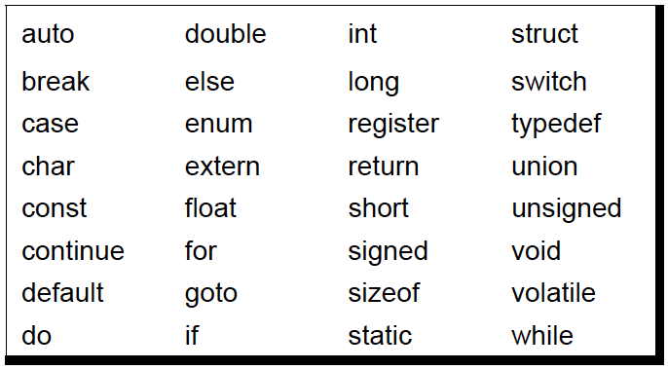
C
There are 32 keywords
All other functionality is provided by library functions
Example printf
Check code written within printf code
Various compilers provide additional functionality
For example MS VC++ may contain additional key words.
Figure taken from “Let Us C” by Yashwant Kanitker, 2004

Slide 8
C is a compiler-based language
Source Code
Compiler
Executable File
Text file containing instruction set
Executable program file
Program that converts human-readable source code into machine readable 0’s and 1’s
Notes:
Compiler based languages are
Fast & efficient
Difficult to reverse engineer

Slide 9
To write and use C
You need a text editor to write the Source code in
textEdit (mac)
NotePad (win)
nano (unix/linux/mac)
A compiler to compile the code for your machine
GNU Compiler Collection (unix).
Use MinGW for Windows. Visit my Public Folder to find out how.
Visual C++ (windows)
XL C (IBM)
Tiny C Compiler (unix and win)

Slide 10
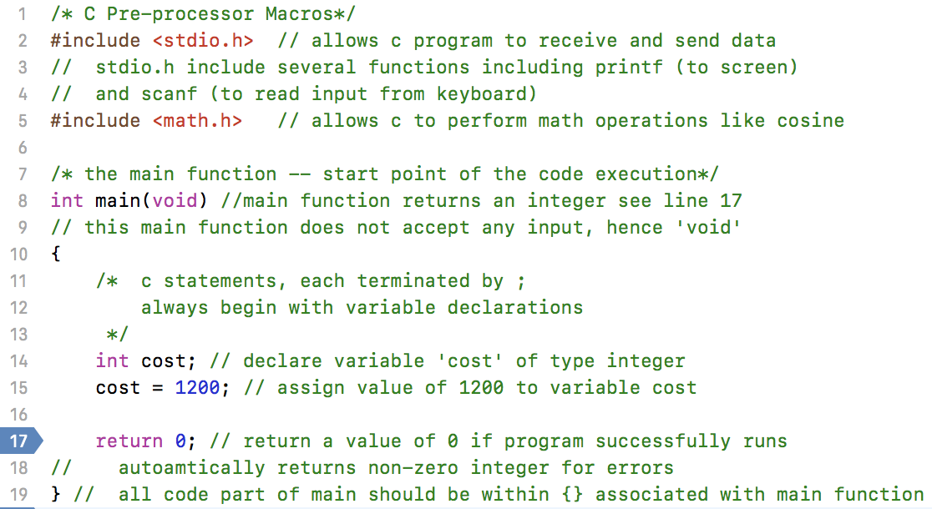
C Code Structure

Slide 11
Compile process
Pre-processing: Remove comments, expand macros & files
Stored in filename.i
Compilation: Compile filename.i into intermediate output file in assembly level instructions
Stored in filename.s
Assembly: Convert filename.s into machine level instructions.
Stored in filename.o
Linking: Link function calls with their definitions. It knows where other functions exist.
Expands code with required instruction set. Ex. Environmental variables.

Slide 12
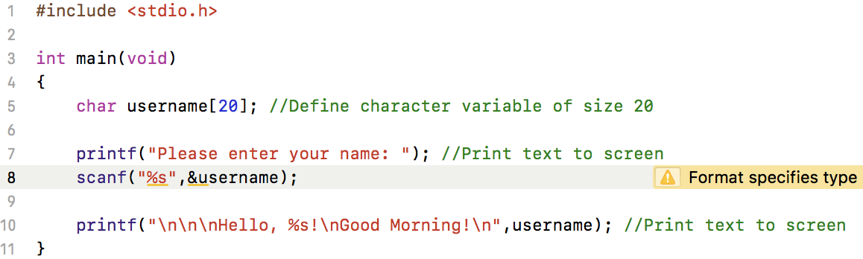
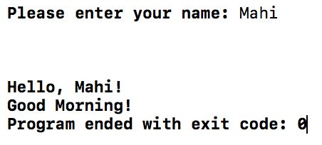
A simple C code

Slide 13
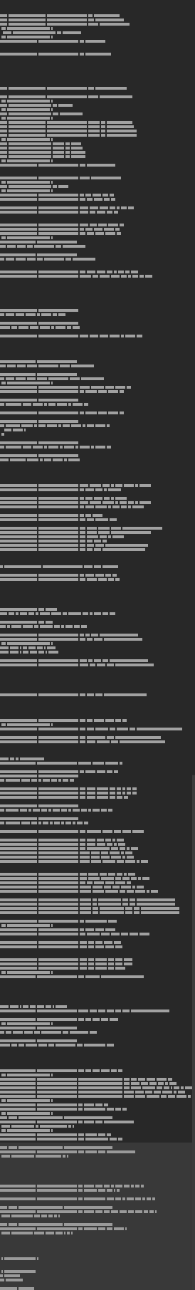
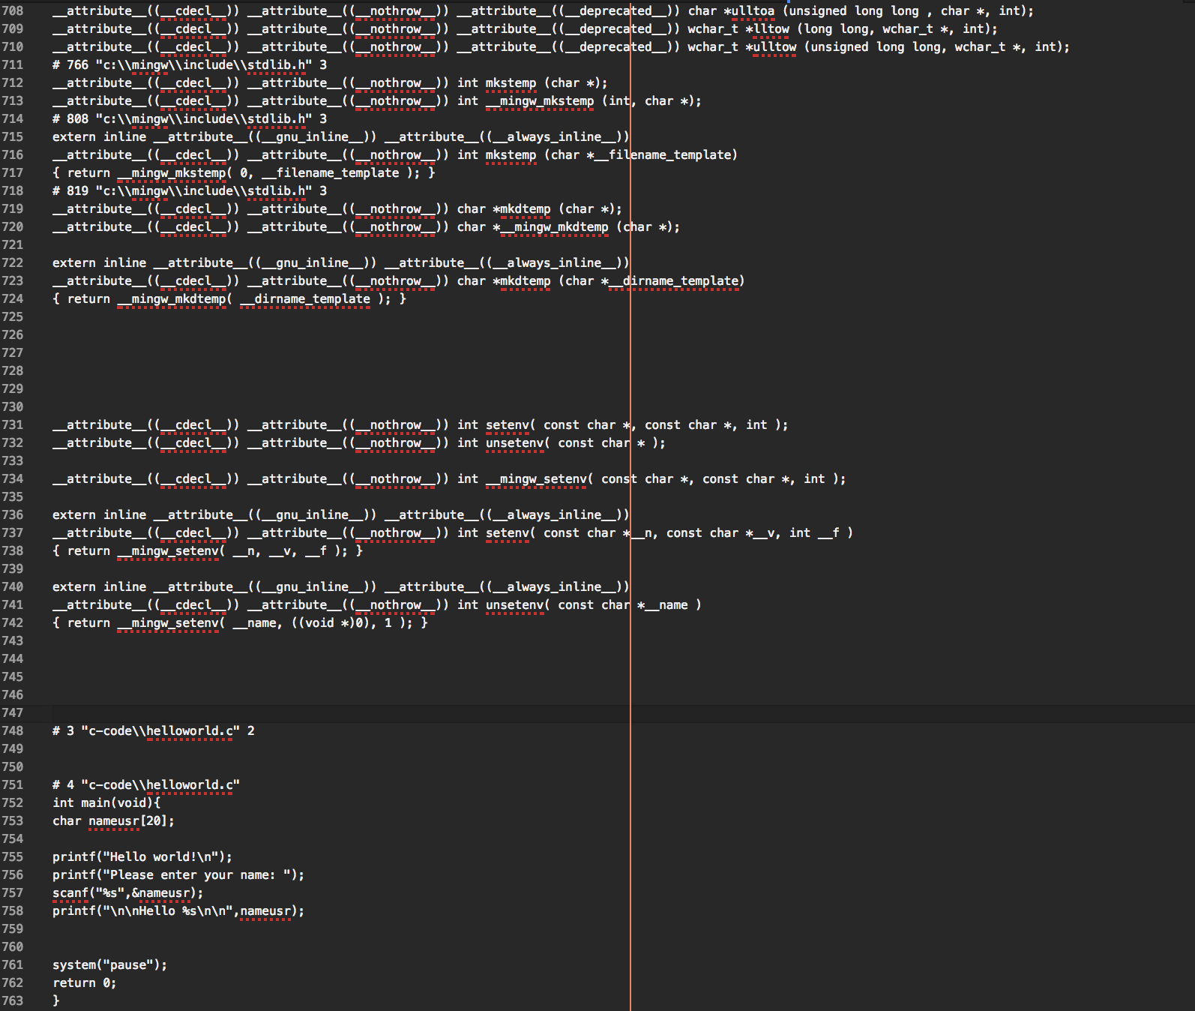
hello.c becomes hello.i

Slide 14
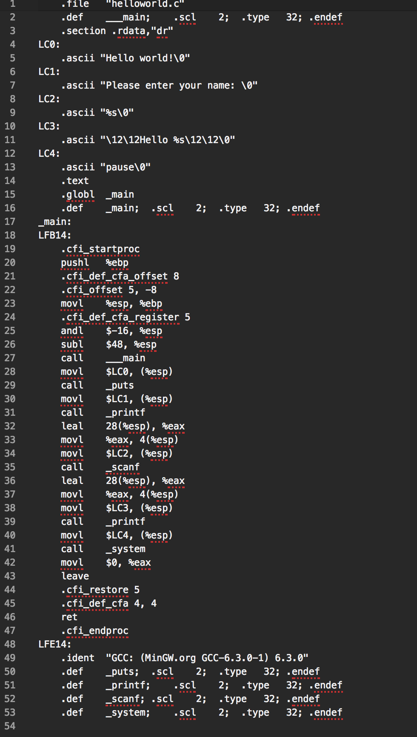
Hello.i becomes hello.s
This file contains assembly instructions

Slide 15
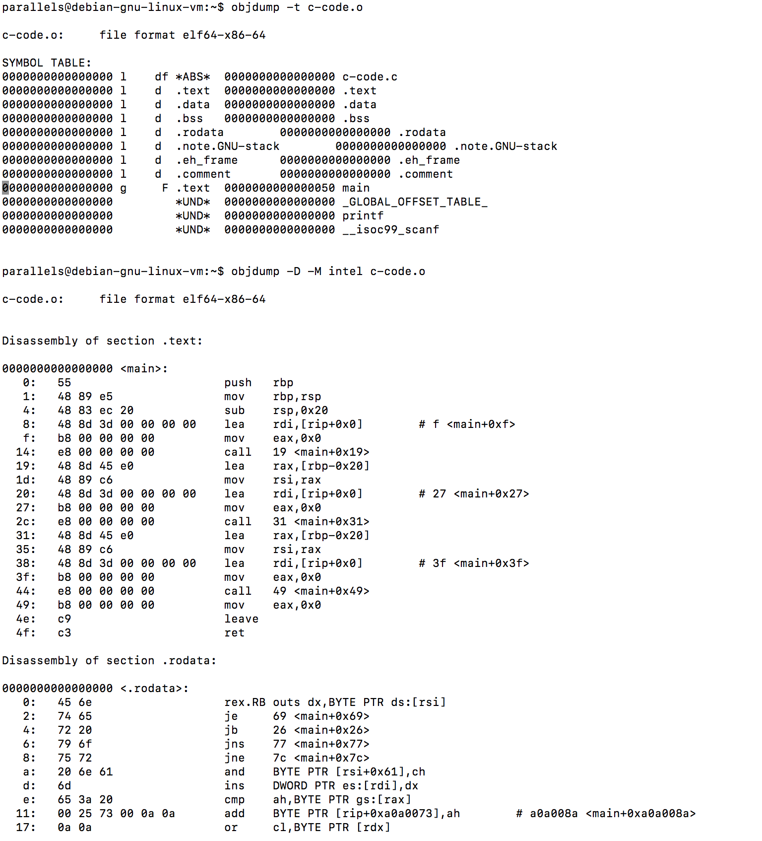
Hello.s becomes hello.o
Called an object file
This file contains machine code

Slide 16
IDE
To help write C code efficiently, we use Integrated Development Environments
Help color code code
Help easily debug
Compile and run code
mac
Xcode
win
MS Visual Studio

Slide 17
C Data Types
In C, you are required to declare the data type of an object in memory (aka variables). This helps the compiler plan out memory etc.
Numeric Data Types in C
int holds an integer value
float holds a real value (decimal place)
Character Data Types in C
char holds a character value
User-defined Types in C
struct can hold combination of data types

Slide 18
C variables
A variable is a named link or reference to the memory location for a stored value.
Example: a=2 ; a is the name given to memory location which now contains a value 2.
In C variables:
Cannot be use reserved C words
Begin with a letter
Can contain numbers and _ (underscores)
Can be 31 characters long
Are case-sensitive

Slide 19
A note on data type
In MATLAB, several background process keep track of variable type and associated name.
x = 5;%an integer
y = 2*x;%y is also an integer
x = 5.3;%not an integer (has decimal points)
z = 3*x;%z is also not an integer
x = ‘Hello’;%a string
disp(x);
C does not do this.
The compiler needs clear information to allocate memory at compile time.

Slide 20
Why does C need declaration
How does your computer store data in its memory?
What is the largest number that can be stored in 8-bit memory?
What is 8-bit memory?
How does a computer store a character?
How does a computer store a signed integer in 8-bits of memory? What is the range of values?
Notes:
Stores as sequence of 0 and 1
Largest number in 8-bit = 2⁸ -1 = 255
8-bit memory can contain 8 binary digits, example 10101001
Uses the 8th bit (left most) to represent sign: 0 = positive, 1=negative
Example: 1000000 is negative number while 00000001 is a positive number.

Slide 21
8-bit data and Characters
Largest number= 8-bit = 2⁸ -1 = 255
Binary |  |  |  |  |  |  |  | Base 10
0 | 0 | 0 | 0 | 0 | 0 | 0 | 0 | 0
0 | 0 | 0 | 0 | 0 | 0 | 1 | 1 | 3
1 | 1 | 1 | 1 | 1 | 1 | 1 | 1 | 255
Binary |  |  |  |  |  |  |  | Character
0 | 1 | 0 | 0 | 0 | 0 | 0 | 1 | A
0 | 1 | 1 | 0 | 0 | 0 | 0 | 1 | a

Slide 22
8-bit data and signed numbers
Unsigned integers (positive), largest number= 8-bit = 2⁸ -1 = 255
Signed integers, largest number = 7-bit = 2⁷-1= 127
Binary |  |  |  |  |  |  |  | Base 10
0 | 0 | 0 | 0 | 0 | 0 | 0 | 0 | 0
0 | 0 | 0 | 0 | 0 | 0 | 1 | 1 | 3
1 | 1 | 1 | 1 | 1 | 1 | 1 | 1 | 255
Binary |  |  |  |  |  |  |  | Base 10
0 | 0 | 0 | 0 | 0 | 0 | 1 | 0 | 0
0 | 0 | 0 | 0 | 0 | 0 | 1 | 1 | 3
0 | 1 | 1 | 1 | 1 | 1 | 1 | 1 | 127
1 | 0 | 0 | 0 | 0 | 0 | 0 | 0 | -128
1 | 0 | 0 | 0 | 0 | 0 | 0 | 1 | -127

Slide 23
How to display data?
C header file stdio.h contains functions to accept keyboard entry and display data to screen.
printf(“string [conversion characters]”,[argument list]);
Example 1:
printf(“Hello world!\nMorning!”);
OUTPUT: Hello world!
Morning!
Example 2:
int result_score=256;
int avg_score=78;
printf(“The result is = %d\nAverage = %d”,result_score,avg_score);
OUTPUT: The result is 256
Average = 78

Slide 24
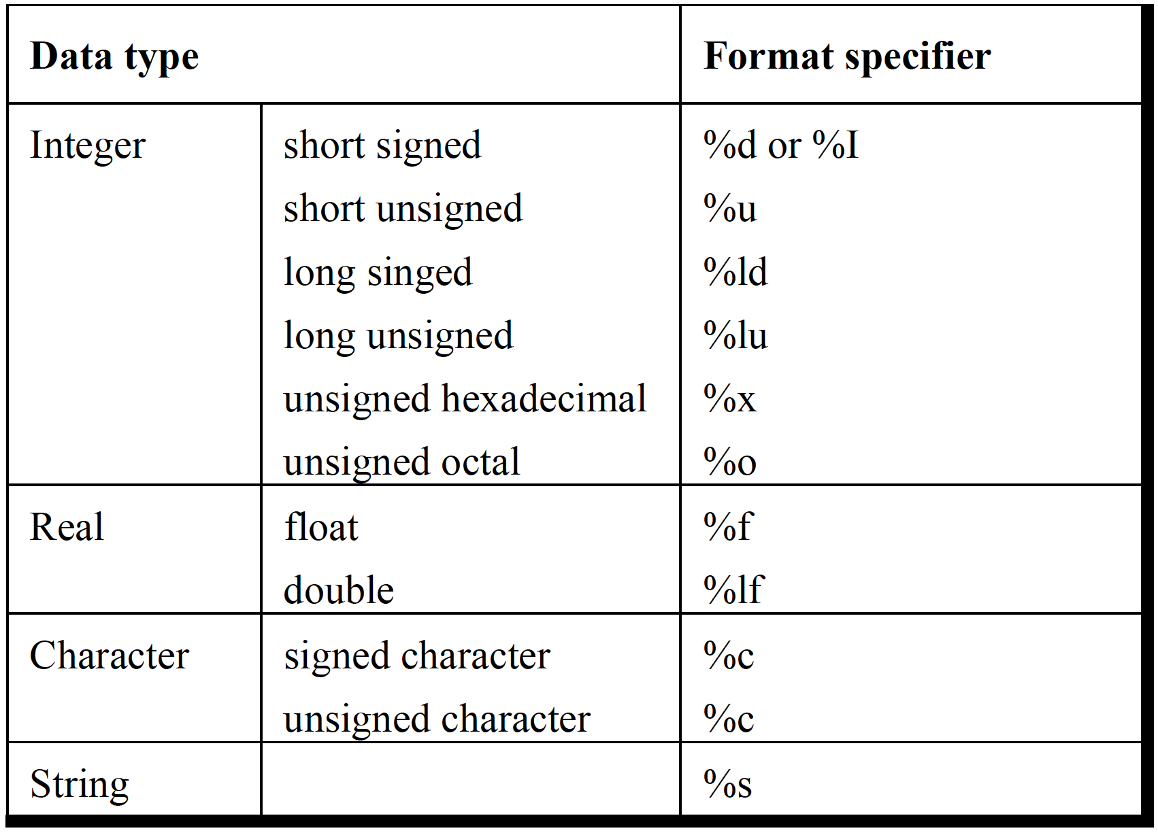
Printf command

Slide 25
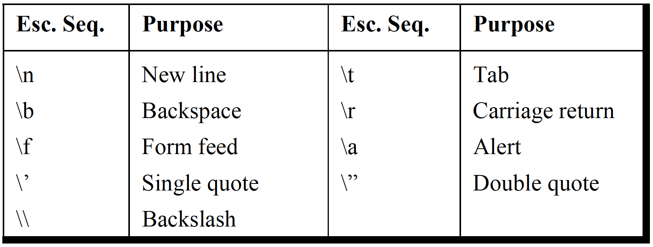
Print f command escape sequence
How do you print a % sign?
Notes:
Use %%
printf(“%%”);
OUTPUT: %

Slide 26
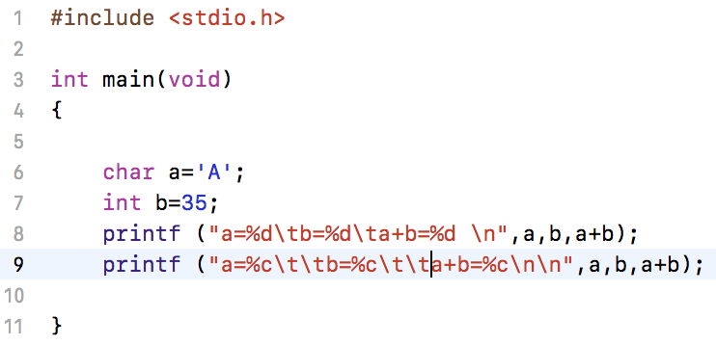
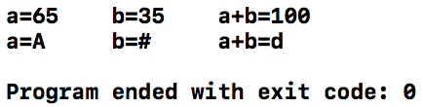
Sample C code

Slide 27
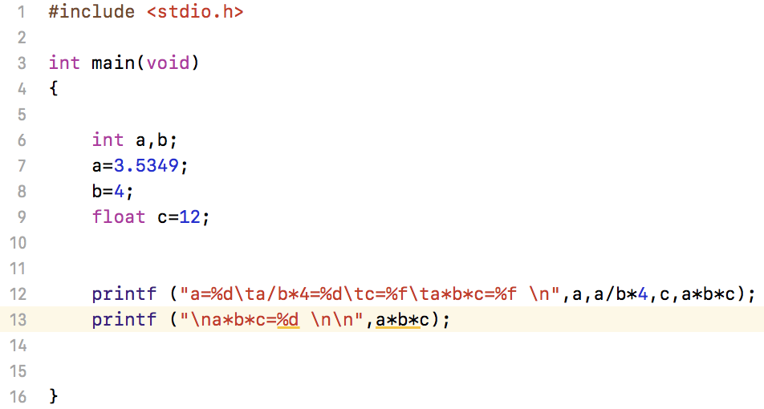
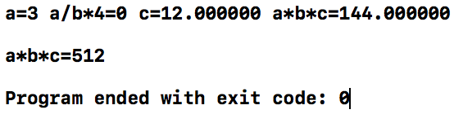
Sample C code

Slide 28
A simple C code
C preprocessor macro aka header file
Required main function

Slide 29
Handout
Download and work on handout

